Slide 1
48v Cryo Board to Cryo Cooler

Slide 2
Materials

Slide 3
Tools

Slide 4
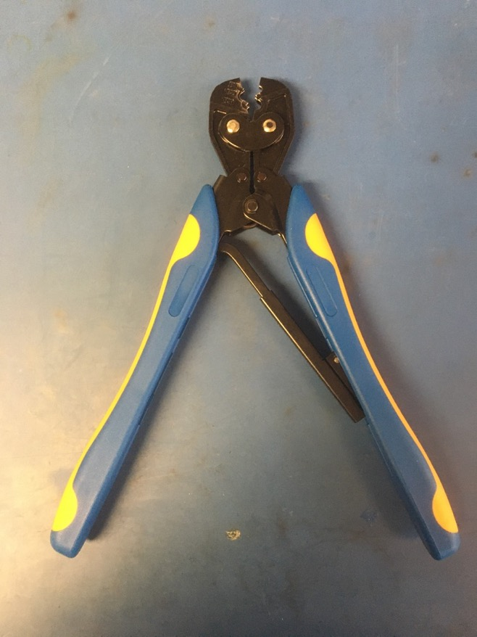
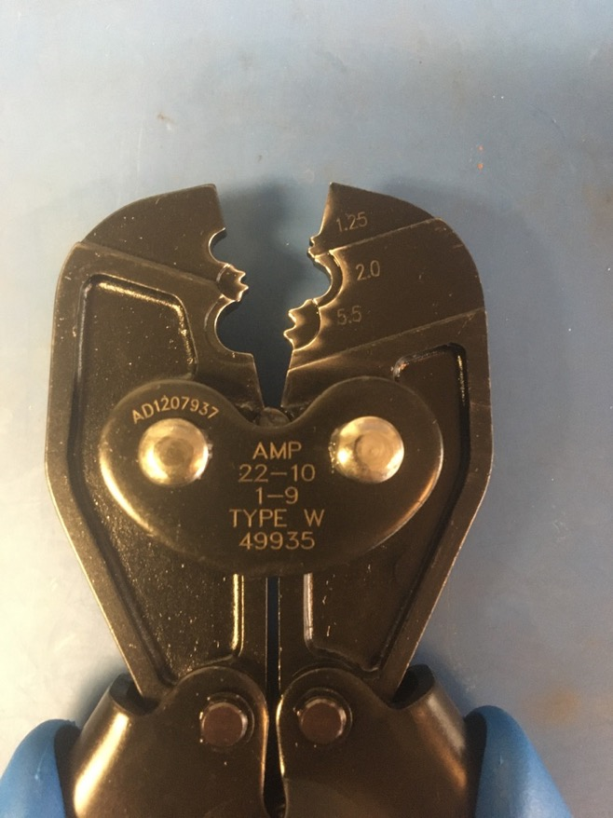
Crimping Tool

Slide 5
Take apart old wire

Slide 6
Measure out and cut blah inches of orange and white 14 awg wire.
Measure out new wire?

Slide 7
Crimp new wire on

Slide 8
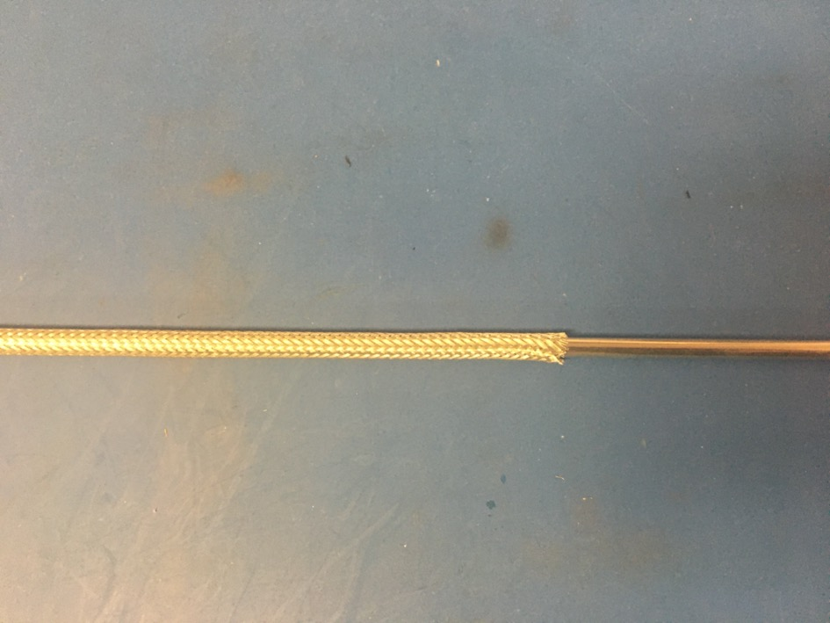
Measure out blah inches of the .203 metal braid. Expand it using the metal rod.
Measure metal braid 30in?

Slide 9
Measure out and cut two lengths of 6.4mm adhesive shrink tube each .5in long.
1/4th?

Slide 10
Put one of the pieces of shrink tube onto the wire harness slide it all the way to the plug. Then put the metal braid onto the wire harness. Put the end of the braid next to the plug and then under the piece of shrink tube. Be sure that the braid ends midway through the piece of shrink tube. Apply the heat gun.
Put on metal braid

Slide 11
Place the other piece of shrink tube on the other end of the metal braid. Again, the braid should end midway through the length of shrink tube. Apply the heat gun.
Metal braid shrink tube

Slide 12
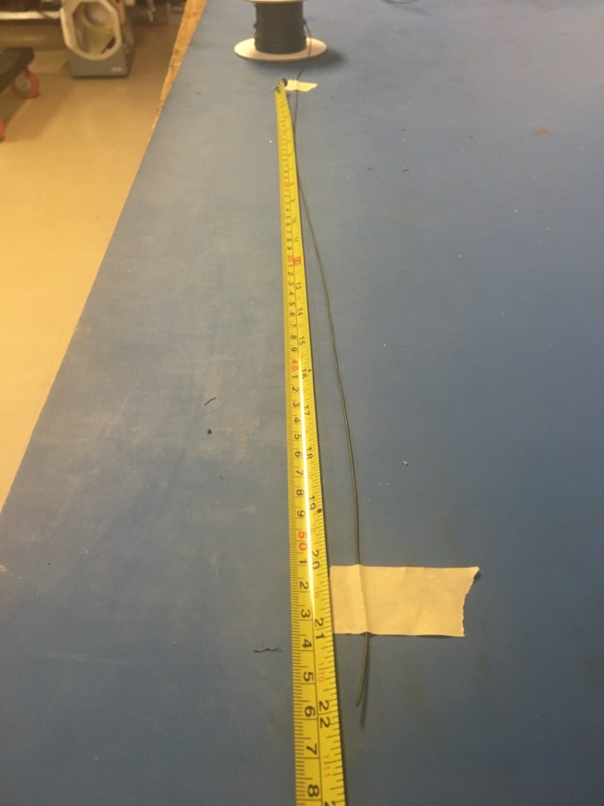
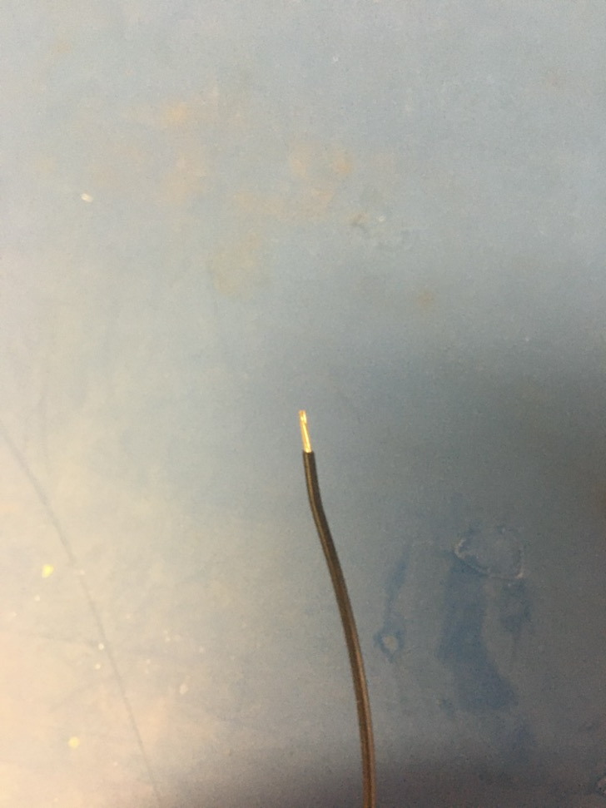
Measure out and cut 22 inches of black 24 awg wires. Strip 3-4mm off one end.

Slide 13
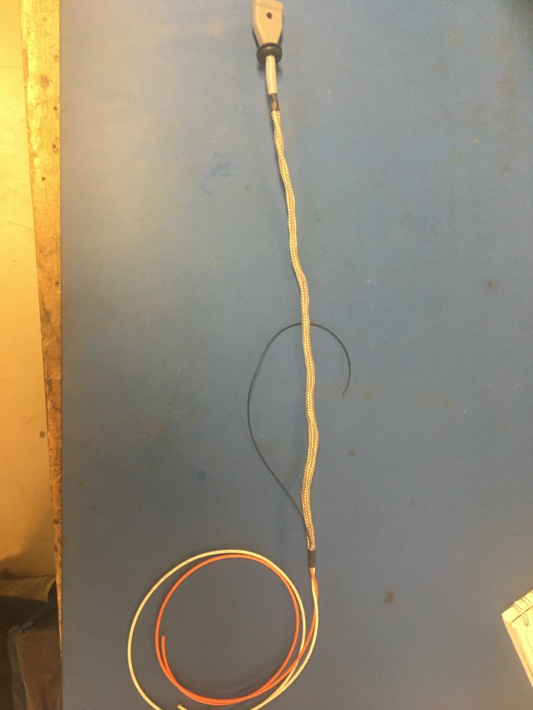
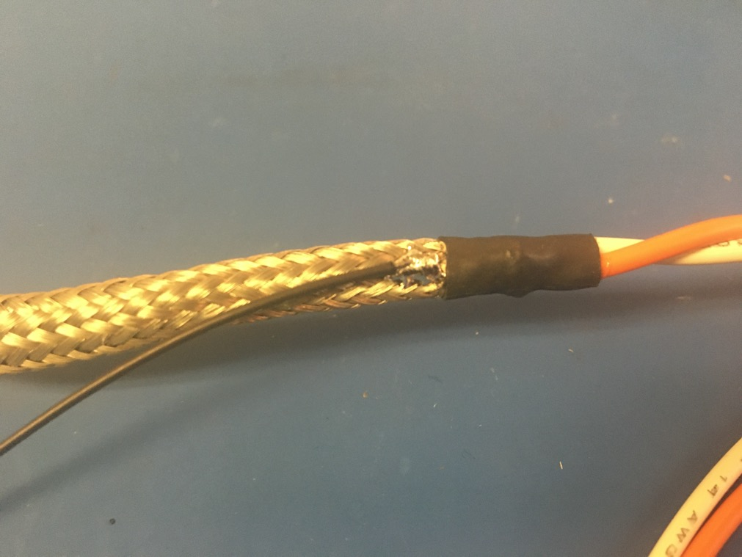
Solder the stripped end of the black wire onto the metal braid near the metal braid shrink tube joint furthest from the plug. The black wire should be soldered so the that its length runs with that of the metal braid.

Slide 14
Measure out and cut blah inches of 1/4th plastic braid.
PB = 17in + (maybe 30in?)

Slide 15
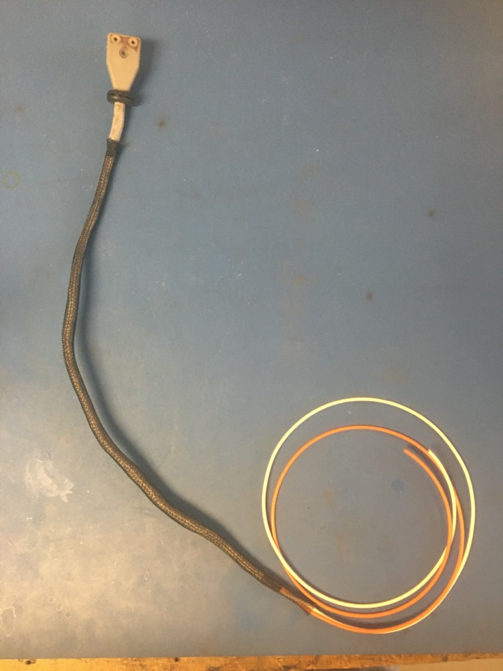
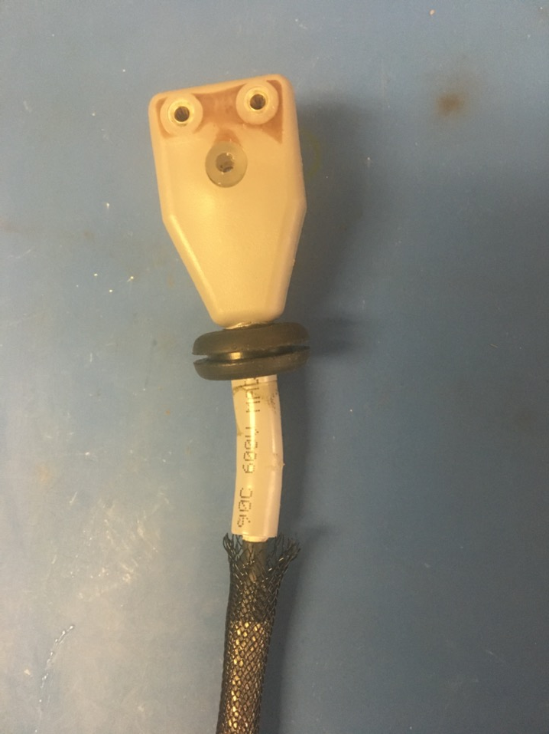
Put the plastic braid onto the wire harness. The end next to the plug should be just touching the end of it as shown on the right.

Slide 16
Measure out and cut two lengths of 12.7mm adhesive shrink tube each 1in long.
12.7mm?

Slide 17
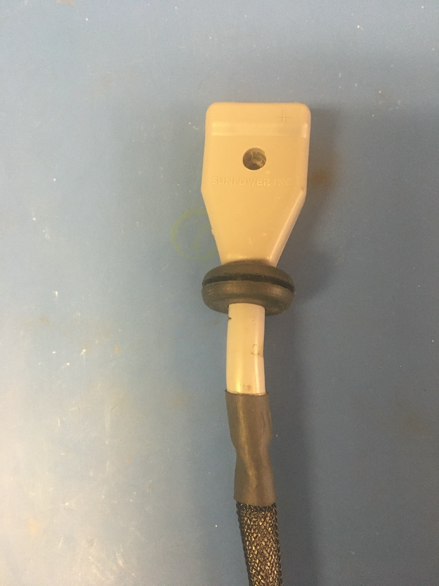
Take one piece of the shrink tube and put it on the plug and plastic braid joint. The end of the plastic braid and beginning of the plug should be in the middle of the length of shrink tube. Apply the heat gun.

Slide 18
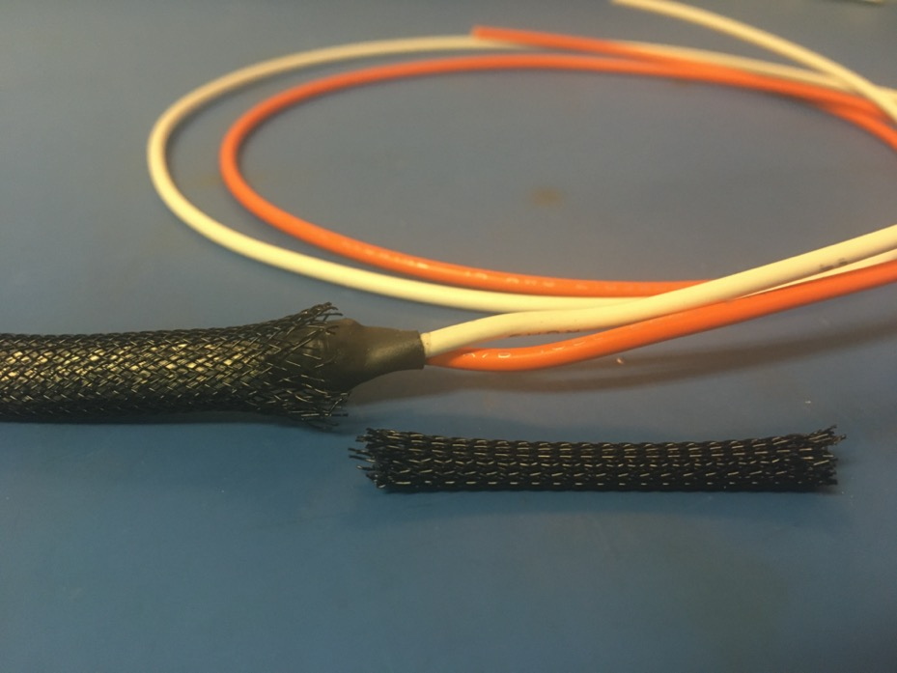
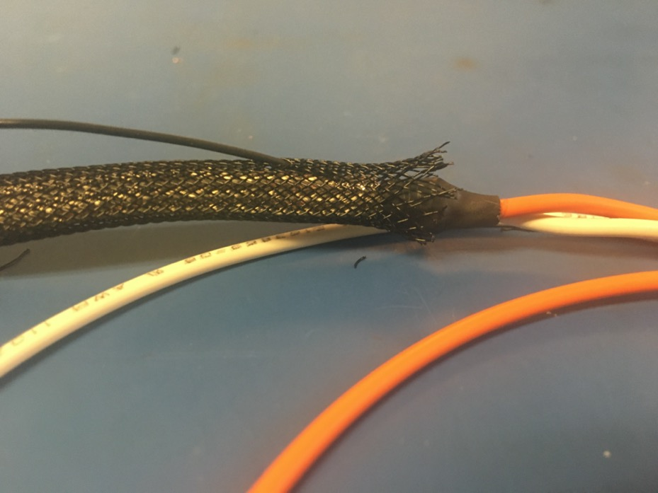
If needed, trim the other end of the plastic braid so it ends midway through the piece of shrink tube underneath it. Thread the ground wire through one of the holes in the plastic braid so it appears as shown of the right.

Slide 19
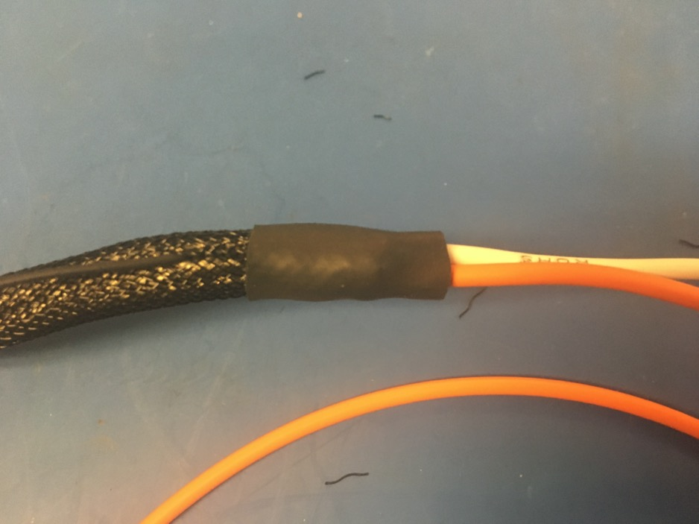
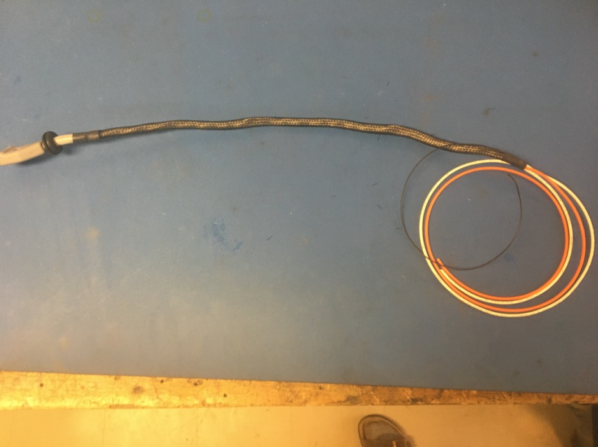
Take the second piece of shrink tube and put it on the remaining exposed end of the plastic braid. The shrink tube should be placed such that it covers the solder joint and the length of shrink tube beneath. Apply the heat gun.

Slide 20
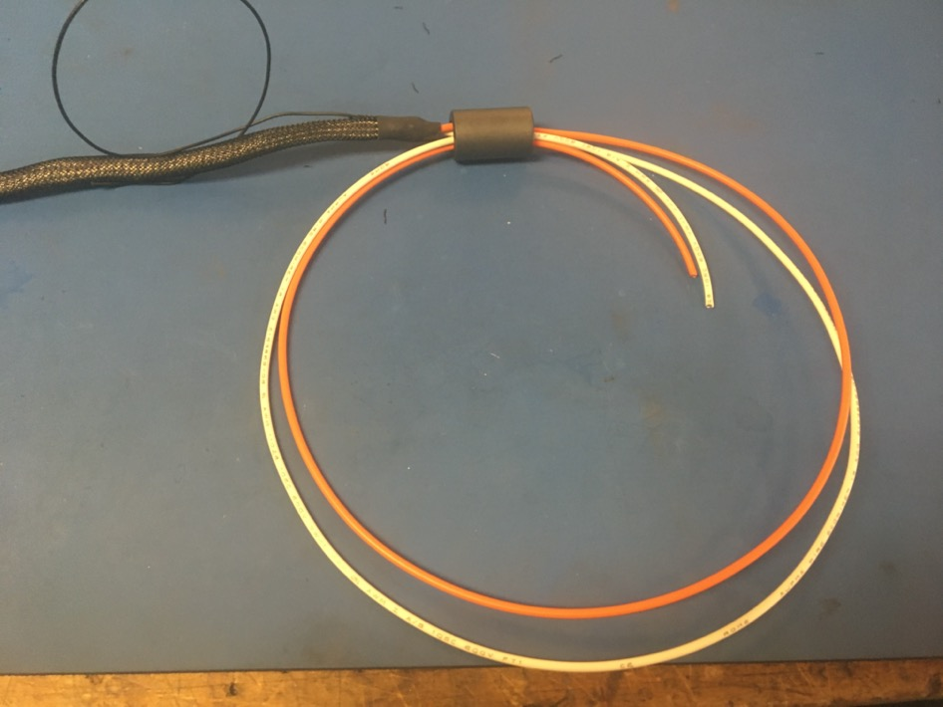
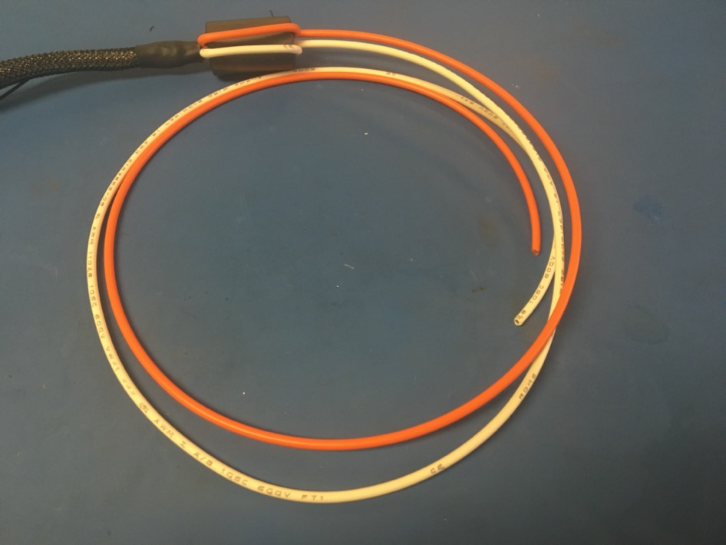
Thread one the 75 magnets onto the end the wires and then back through the bottom of the magnet as shown on the left. Pull the loop of wire taught so they appear as shown on the right. When pulling the loop of wire through, try to keep the wires parallel.

Slide 21
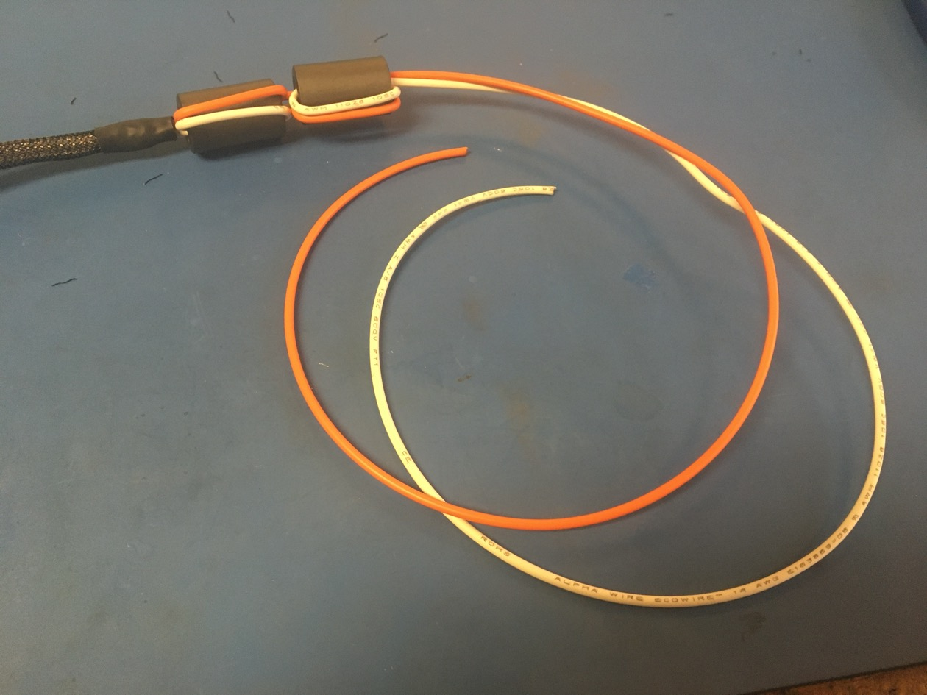
Repeat the process shown on the previous slide with the second 75 magnet.

Slide 22
Measure out and cut one length of 6.4mm adhesive shrink tube that is 1in long.
1in of ¼?

Slide 23
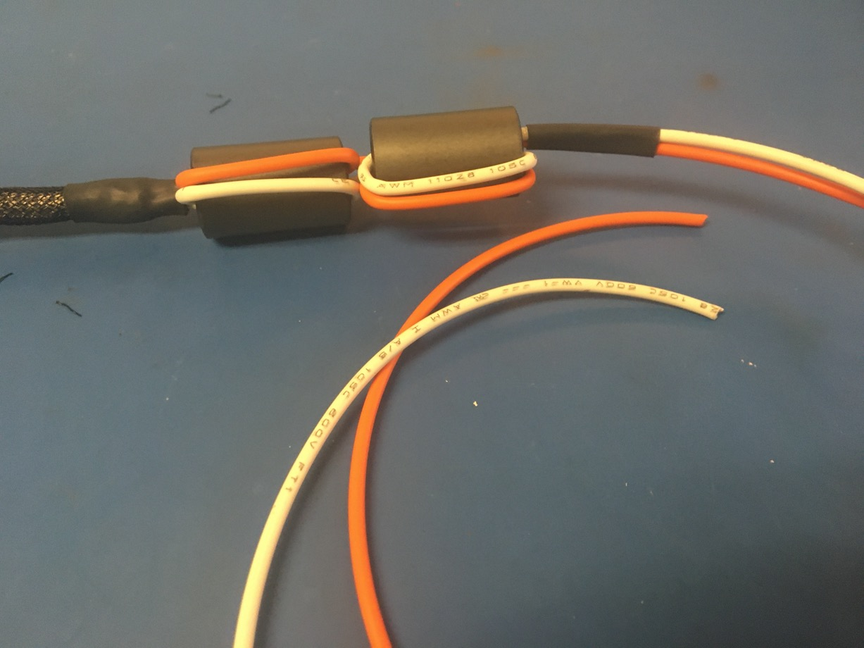
Place the piece of shrink tube such that it abuts the magnets. Apply the heat gun.

Slide 24
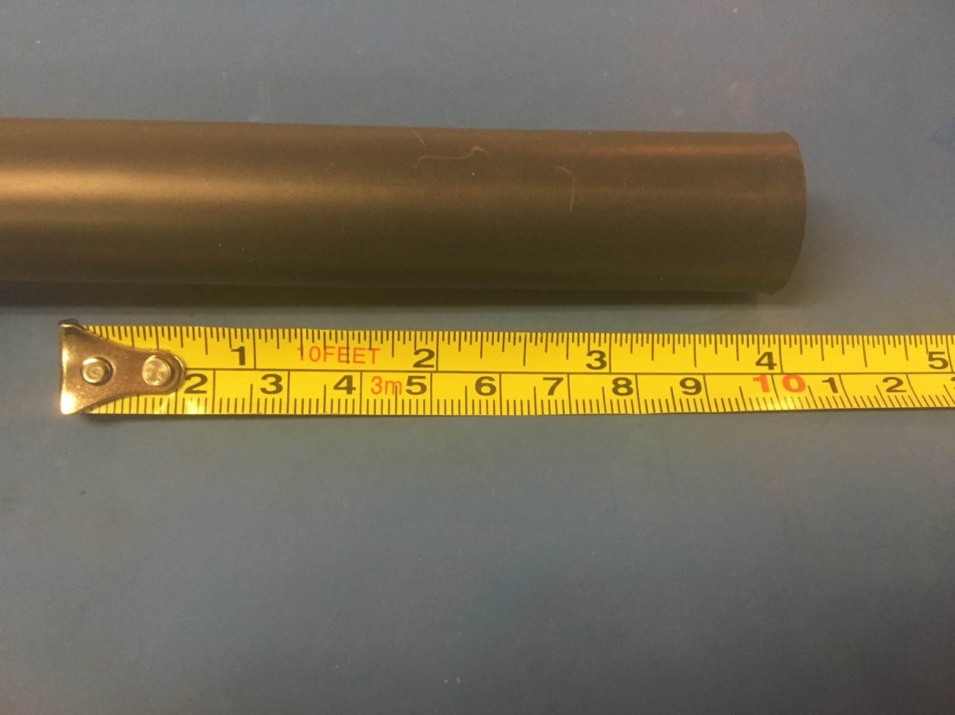
Measure out and cut one length of 19mm adhesive shrink tube that is 4in long.
19mm?

Slide 25
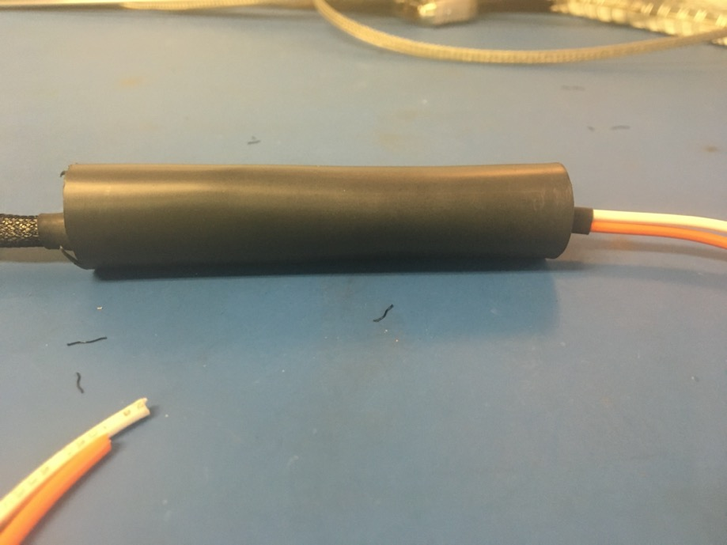
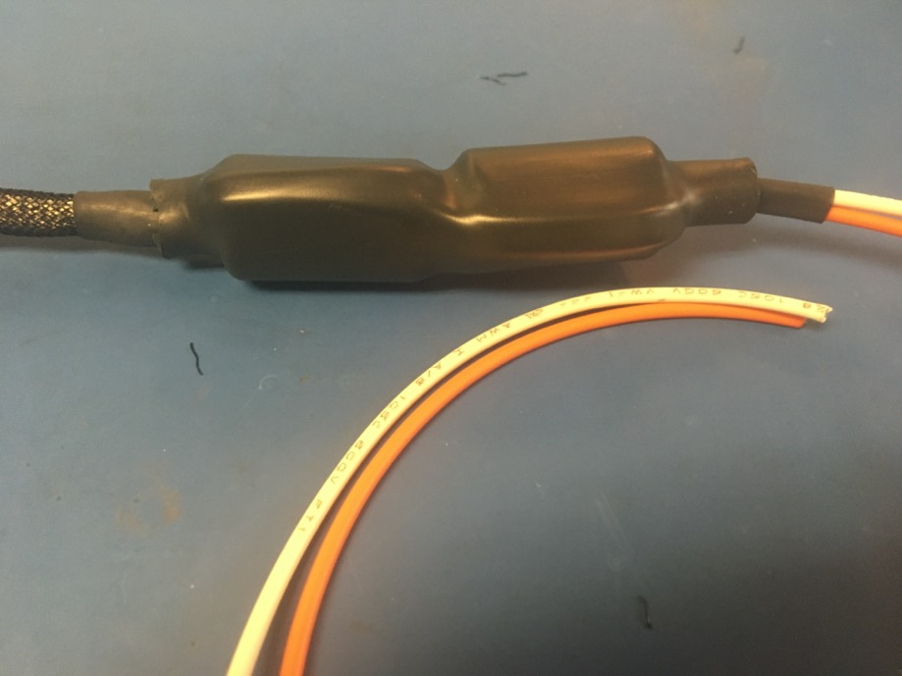
Place the piece of 19mm shrink tube over the magnets so that roughly the same amount of shrink tube is visible coming out either end. Apply the heat gun.

Slide 26
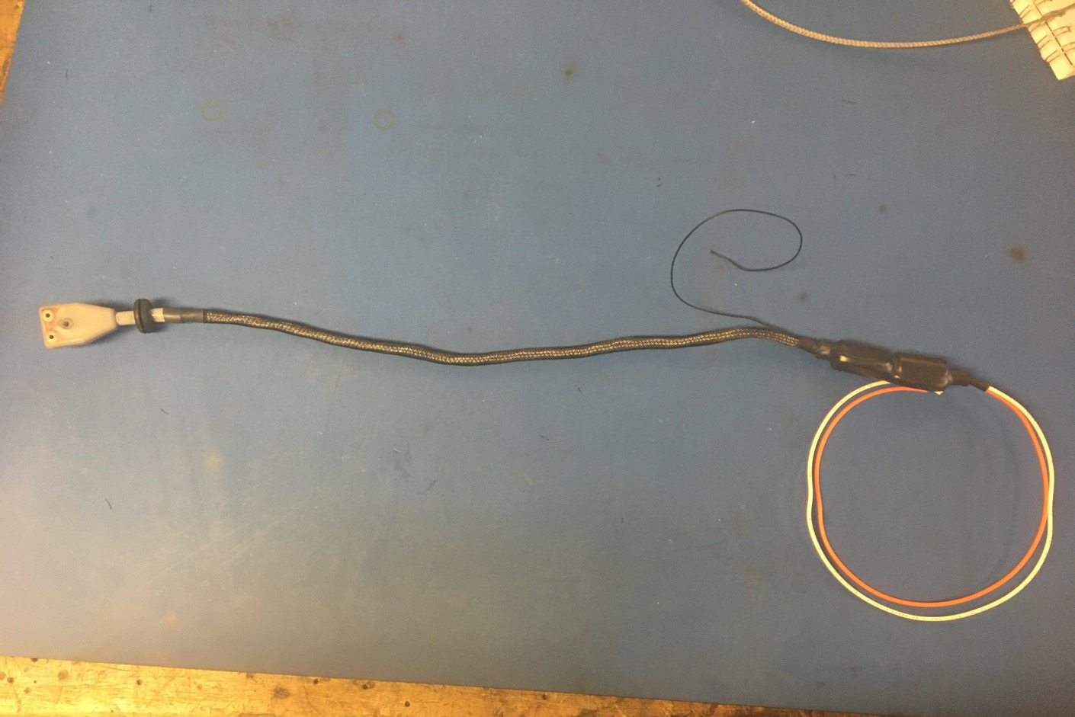
Wire harness complete! The orange, white, and ground wire will be given tips later.

